Slide 1
DATABASE MANAGEMENT SYSTEMS
COURSE CODE : 21CA1204

Slide 2
UNIT - 1
INTRODUCTION, DATABASE DESIGN AND RELATIONAL MODEL
Introduction
Database System Applications,
Purpose of Database Systems,
View of Data
Database Languages,
Database and Application Architecture
Database Users and Administrators
Database Schema
Keys
Schema Diagrams
ER diagrams
Mapping Cardinalities
Alternatives Notations for Modeling Data – Data Flow Diagram.

Slide 3
INTRODUCTION

Slide 4
DATA
Data refers to raw facts
Data may be numerical data which may be integers or floating point numbers, and non-numerical data such as characters, date and etc.,

Slide 5
Example
98
89
87
92
phy
chem
maths
biology
The above numbers may be anything: It may be distance in kms or amount in rupees or no of days or marks in each subject etc.,

Slide 6
Information
Processed Data is referred as Information. It delivers some meanings to the user
phy
chem
maths
biology
98
89
87
92

Slide 7
Database
Database is an organized, collection of related information
Eg. telephone directory, dictionary, and college database.
phy
chem
maths
biology
98
89
87
92
phy
chem
maths
biology
76
87
79
88
phy
chem
maths
biology
86
80
79
88
phy
chem
maths
biology
91
67
87
77

Slide 8
Database Management Systems
A database management system or DBMS is software designed to store, modify, maintaining and utilizing large collection of data.
A database-management system (DBMS) is a collection of interrelated data and a set of programs to access those data
Database Applications:
  Banking: all transactions
  Airlines: reservations, schedules
  Universities: registration, grades
  Sales: customers, products, purchases
  Online retailers: order tracking, customized recommendations
  Manufacturing: production, inventory, orders, supply chain
  Human resources: employee records, salaries, tax deductions
Databases touch all aspects of our lives

Slide 9
Why do u need a DBMS?
A Database Management System Is an Extension of Human Logic
Computers Can Quickly Answer Lots of Questions
Some Questions Can Be Really Complicated
We Are Easily Overwhelmed With Information
Automation Is the Key to Efficiency
A DBMS Is Better Than Manual Processes in so Many Ways

Slide 10
DATABASE APPLICATIONS

Slide 11
ENTERPRISE INFORMATION
Sales: For customer, product, and purchase information.
Accounting: For payments, receipts, account balances, assets and other accounting information.
Human resources: For information about employees, salaries, payroll taxes, and benefits, and for generation of paychecks.
Manufacturing: For management of the supply chain and for tracking production of items in factories, inventories of items inwarehouses and stores, and orders for items.
Online retailers: For sales data noted above plus online order tracking, generation of recommendation lists, and maintenance of online product evaluations

Slide 12
Banking and Finance
◦ Banking: For customer information, accounts, loans, and banking transactions.
◦ Credit card transactions: For purchases on credit cards and generation of
monthly statements.
◦ Finance: For storing information about holdings, sales, and purchases of
financial instruments such as stocks and bonds; also for storing real-time
market data to enable online trading by customers and automated trading
by the firm.

Slide 13
Universities
For student information, course registrations, and grades (in addition to standard enterprise information such as human resources and accounting).

Slide 14
Airlines: For reservations and schedule information. Airlines were among the first to use databases in a geographically distributed manner.
Telecommunication: For keeping records of calls made, generating monthly bills, maintaining balances on prepaid calling cards, and storing information about the communication networks.

Slide 15
Database Systems Vs File Systems
FILE BASED DATA MANAGEMENT
Before advent of database , file system—manual file system was used
1) Collection of file, folders each tagged and kept in a filing cabinet
2) When data was relatively small—few reporting requirements—manual system was ok
3) Requirements grew—manual system complex (files, folders collection growing—time consuming & cumbersome

Slide 16
The conventional file system was much faster and efficient than manual counterparts but not flexibly than modern DBMS.
DISADVANTAGE OF FILE BASE SYSTEM
Need for programming and skilled personnel
Need different application programs
  to extract records
  to add records etc
For Each query an application program has to be written
For different reports to be generate, different programs to be written
Lack of data security
Password security alone is maintained and it is not sufficient when different users have access permissions to different subsets of data
To safeguard confidentiality was difficult
To lock part of files or part of the system not possible

Slide 17
Information compartmentalization
Promote data ownership and thus promoting the storage of same data in different location
Professional says as information islands or information compartmentalization, data at different locations are to be consistently updated, islands of information often contains different versions of data
Structural Dependency
Change in file structure/addition/deletion of a field requires modification of all programs using that files
It exhibits structural dependency
Changing from integer to decimal will make change in program

Slide 18
Data Dependency
File data characteristic change
Normal representation is ASCII
Specify opening of a specific file type either random or sequential
How to store and how to retrieve is to be clearly defined
Data Redundancy
Employee details stored in personnel dept ,account department, production planning department etc
Data Inconsistency
Data stored at different location / departments and modification / deletion / addition can create data inconsistencies
Eg:-employee leaves organization should be properly updated in all departments

Slide 19
Concurrent access by multiple users
Concurrent accessed needed for performance
Uncontrolled concurrent accesses can lead to inconsistencies
  Example: Two people reading a balance and updating it at the same time
Security problems
Hard to provide user access to some, but not all, data

Slide 20
ADVANTAGE OF DBMS
Data independence
Application programs should be independent as possible from details of data representation & storage.
Efficient data access
Data can be effectively retrieved when data is stored on external storage device
Data integrity & Security
DBMS can enforce integrity constraints on data
DBMS can check, before inserting salary for an employee the dept budget not exceeded.
Security restrictions can be applied
Access controls is enforced
What data is visible to different classes of users
Data administration
When several users share data centralizing the administration of data can offer significant improvements

Slide 21
Concurrent access and crash recovery
Concurrent access to data, in such a manner that users can think of the data being accessed by only one user at a time
DBMS protects users from effects of system failures
Reduced application development time
It supports many important functions that are common to much application accessing data stored in the DBMS
Describing and storing data in a DBMS
A data model is a collection of high level data description that hide many low level storage details.
Conflicting requirements can be balanced
Knowing the overall requirements helps database designers in creating a database design that is best for the organization

Slide 22
View of Data / Database Architecture

Slide 23
DBMS Architecture
The DBMS architecture describes how data in the database is viewed by the users.
Database abstraction also hides the implementation details of the data from the user
The major purpose of a database system is to provide users with an abstract view of the data i.e.
The system hides certain details of how the data are stored and maintained.

Slide 24
Example to Understand Abstraction
User Level
A layman is walking on the street in front of your college.
When he looks at your college what all does he knows about the college!
He knows the name of the college then he might know that it is a Science or Arts college, it is run by so a so society etc.

Slide 25
Logical Level
You are a student of the college
You know more about the person on the street
You know the number of courses held in the college, most of the teachers in the college, the course fees of the course which you are learning, the different buildings of the college etc.

Slide 26
Physical Level
Now, consider the administrative staff of the college.
These people know even more information about the college than a student of the college
like how courses are conducted,
how teachers are appointed,
what is the fee structure of the courses
what new courses are to be started etc.
Now, these 3 people are looking at the same thing (i.e. the college) from 3 different levels of abstraction.

Slide 27
3 Levels of Abstraction
The architecture is defined at 3 levels. This architecture is proposed by ANSI/SPARC (American National Standards Institute/Standards Planning and Requirements Committee) and hence, is also known as ANSI/SPARC architecture
  Physical level / Internal Level
  Logical level / Conceptual
  View or external level

Slide 28
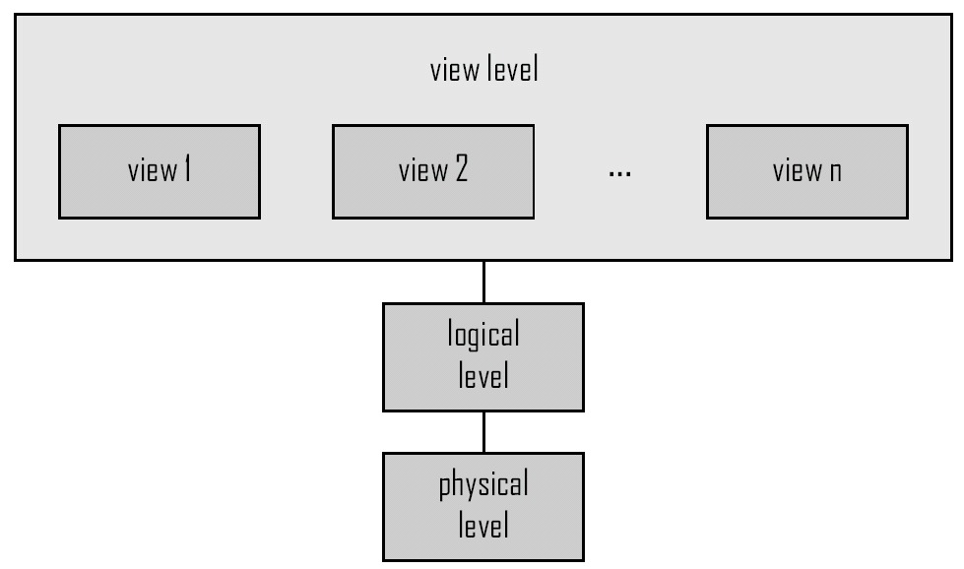
DBMS Architecture Diagram

Slide 29
Physical level
Lowest level of abstraction.
It describes how the data are actually stored.
It describes data structures in detail.
At this level achieve various aspects are considered for optimal runtime performance and storage space utilization.
These aspects include storage space allocation techniques for data and indexes, access paths such as indexes, data compression and encryption techniques, and record placement

Slide 30
Logical level
Next level of abstraction.
It describes what data are stored in database and what relationship exists between those data.
Defines all database entities, their attributes, and their relationships
Security and integrity information

Slide 31
View or external level
It describes only some part of entire database.
It access only database and not concerned about physical storage location and data structures.

Slide 32
Student information it contains
  studentid
  stuname
  stuage
  stusex
  stugrade
Physical level:
Student information are stored as block of consecutive storage locations. 79 memory locations are needed.
Logical level:
Char stuid [25], stuname [50], stusex, and stugrade;
int age;
External level:
It uses set of application program to retrive data from database
Select * from student where stuid=’1001’;

Slide 33
Instances and Schemas
Similar to types and variables in programming languages
Schema –Overall design of a database is called as schema
  Example: The database consists of information about a set of customers and accounts and the relationship between them)
  Analogous to type information of a variable in a program
  Physical schema: database design at the physical level
  Logical schema: database design at the logical level
Instance
Collection of information stored in the database at a particular moment is called an instance of a database.
  Analogous to the value of a variable
Physical Data Independence – the ability to modify the physical schema without changing the logical schema
  Applications depend on the logical schema
  In general, the interfaces between the various levels and components should be well defined so that changes in some parts do not seriously influence others

Slide 34
Eg of instance & schema:
In a program, various variable declarations are referred as schema.
Every variable has a particular value at a given instance of database schema
Database schemas
3 types of schemas:
  1. Conceptual schema.
  2. Physical schema/ internal.
  3. Logical schema/external.

Slide 35
Database Schemas
External schema 1
External schema 2
External schema 3
Conceptual schema
Physical schema
disk

Slide 36
Instances and Schemas
DB Schema Diagram for a Company:
Employee:
Eno
Ename
Salary
Address

Slide 37
Instances and Schemas
        DB Schema Diagram for a Company:
Department:
Dno
Dname
Dlocation
Project:
Pno
Pname
Hours

Slide 38
Instances and Schemas
Instance Example:
Eno
Ename
Salary
Address
1
2
3
A
B
C
10,000
20,000
30,000
First street
Second street
Third street

Slide 39
CONCEPTUAL SCHEMA
It describes all relations that are stored in the database
Students(sid :strings,name :strings,age:integer)
Faculty(fid :string,fname:string,sal:real)
Courses(cid:string,cname:string
Rooms(rno:integer,address:string,capacity:integer)
Enrolled(sid:string,cid:string,grade:string)
Teachers(fid:string,cid:string)
Meets-in(cid:string,rno:integer,time:string)

Slide 40
Physical Schema
It specifies additional storage details.
The relations described in conceptual schema are actually stored in a secondary storage devices such as disks, tapes etc.
What file org is used to store the relations

Slide 41
External Schema
It allows data access to be customized at the level of individual users.
Only one conceptual schema and one physical schema but may have several external schemas each tailored to particular group of users.
A view is conceptually a relation but the records in a view are not stored in DBMS.
Suited for end user requirement.

Slide 42
Mapping
Whenever a user specifies a request to generate a new external view, the DBMS must transform the request specified at external level into a request at conceptual level, and then into a request at physical level.
This process of transforming the requests and results between various levels of DBMS architecture is known as mapping.

Slide 43
Data Independence
The main advantage of three-schema architecture is that it provides data independence.
Data independence is the ability to change the schema at one level of the database system without having to change the schema at the other levels.
Data independence is of two types, namely, logical data independence and physical data independence.

Slide 44
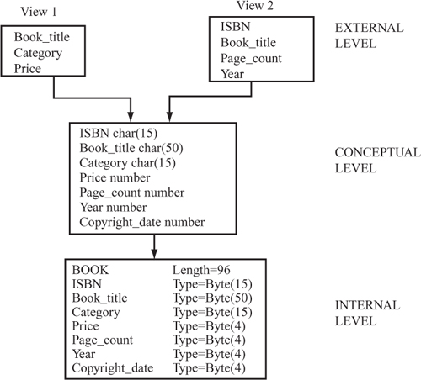
Three Levels of online Book Database

Slide 45
Logical Data Independence
It is the ability to change the conceptual schema without affecting the external schemas or application programs.
The conceptual schema may be changed due to change in constraints or addition of new data item or removal of existing data item, etc., from the database.
The separation of the external level from the conceptual level enables the users to make changes at the conceptual level without affecting the external level or the application programs.
For example, if a new data item, say Edition is added to the BOOK file, the two views (view 1 and view 2 shown in the above Figure) are not affected.

Slide 46
Physical Data Independence
Physical data independence: It is the ability to change the internal schema without affecting the conceptual or external schema.
An internal schema may be changed due to several reasons such as for creating additional access structure, changing the storage structure, etc.
The separation of internal schema from the conceptual schema facilitates physical data independence.

Slide 47
Logical data independence is more difficult to achieve than the physical data independence because the application programs are always dependent on the logical structure of the database.
Therefore, the change in the logical structure of the database may require change in the application programs.

Slide 48
Data Models
A data model is an organizing principle that specifies particular mechanisms for data storage and retrieval
The primary difference between the various database models lie in the method of expressing relationships and constraints among data elements

Slide 49
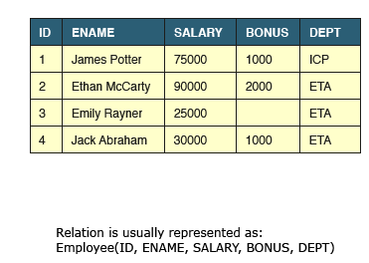
RELATIONAL MODEL
Relational Databases store data in relations i.e. tables.
Each relation must have a name.
Relation can be otherwise called as object or Table

Slide 50
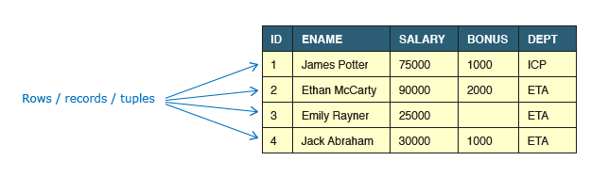
Tuple/Row/Record
A single entry in a table is called a Tuple or Record or Row.
A tuple in a table represents a set of related data. For example, the above Employee table has 4 tuples/records/rows.
A record is a set of related data in a table.

Slide 51
ATTRIBUTES
A table consists of several records(row), each record can be broken down into several smaller parts of data known as Attributes
An attribute is a named column of a relation. It stores a specific information about an object / Table e.g. salary.
Name the Attributes
The above Employee table consist of five attributes, ID, ENAME, SALARY, BONUS, DEPT
Attribute Domain : Attribute is defined to hold only a certain type of values, which is known as Attribute Domain.
The attribute Name will hold the name of employee for every tuple. If we save employee's address there, it will be violation of the Relational database model.

Slide 52
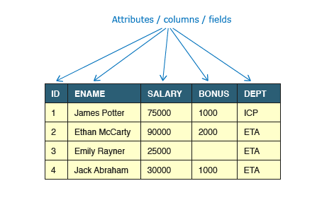
ATTRIBUTES

Slide 53
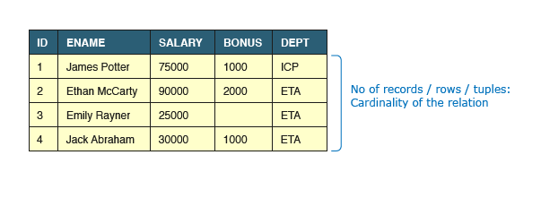
CARDINALITY OF THE RELATION

Slide 54
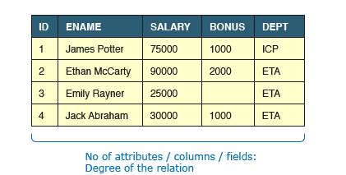
DEGREE OF THE RELATION

Slide 55
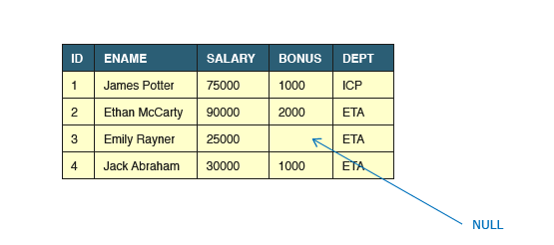
NULL ATTRIBUTE
The attribute value that is currently unknown is called Null Attribute

Slide 56
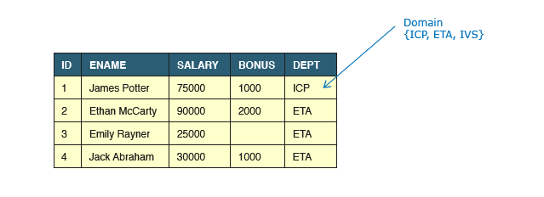
Attribute Domain
Attribute is defined to hold only a certain type of values, which is known as Attribute Domain.

Slide 57
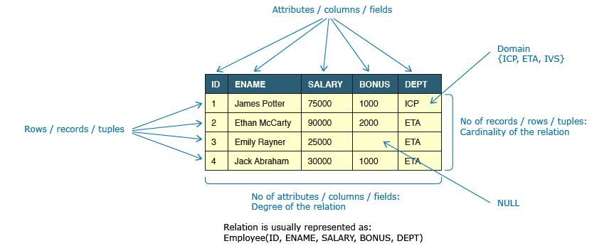

Slide 58
Data Integrity and Constraints / Keys
Integrity constraints are a set of rules. Integrity constraints ensure that the data insertion, updating, and other processes have to be performed in such a way that data integrity is not affected.
Thus, integrity constraint is used to guard against accidental damage to the database.
Data integrity refers to maintaining and assuring the accuracy and consistency of data over its entire life-cycle.
Database Systems ensure data integrity through constraints which are used to restrict data that can be entered or modified in the database.
Database Systems offer three types of integrity constraints:

Slide 59
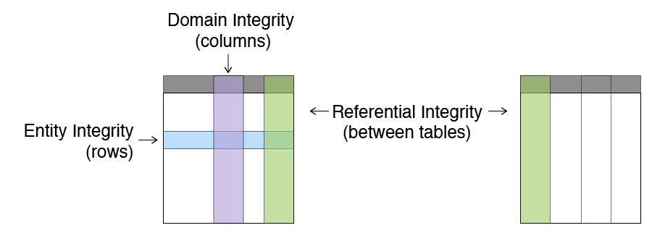
Types of Integrity

Slide 60
Integrity Types | Definition | Enforced Through
Entity Integrity | Each table must have a column or a set of columns through which we can uniquely identify a row. These column(s) cannot have empty (null) values. | PRIMARY KEY
Domain Integrity | All attributes in a table must have a defined domain i.e. a finite set of values which have to be used. When we assign a data type to a column we limit the values that it can contain. In addition we can also have value restriction as per business rules e.g. Gender must be M or F. | DATA TYPES, CHECK CONSTRAINT
Referential Integrity | Every value of a column in a table must exist as a value of another column in a different (or the same) table. | FOREIGN KEY

Slide 61
Keys
Super Key
Candidate Key
Primary Key

Slide 62
Super Key
A super key is a set of one or more attributes (columns), which can uniquely identify a row in a table.
Often DBMS beginners get confused between super key and candidate key
Let’s take an example to understand this:
Table: Employee
Emp_SSN | Emp_Number | Emp_Name
123456789 | 226227 | Steve
999999321 | 227 | Ajeet
999999322 | 228 | Chaitanya
777778888 | 229 | Robert

Slide 63
Super keys: All of the following sets of super key are able to uniquely identify a row of the employee table.
{Emp_SSN}
{Emp_Number}
{Emp_SSN, Emp_Number}
{Emp_SSN, Emp_Name}
{Emp_SSN, Emp_Number, Emp_Name}
{Emp_Number, Emp_Name}

Slide 64
1. {Emp_Id} – No redundant attribute
2. {Emp_Number} – No redundant attributes
3. {Emp_Id, Emp_Number} – No Redundant attribute. Either of those attributes can be a minimal super key as both of these columns have unique values.
4. {Emp_Id, Emp_Name} – Redundant attribute Emp_Name
5. {Emp_Id, Emp_Number, Emp_Name} – Redundant attributes. Emp_Id or Emp_Number alone are sufficient enough to uniquely identify a row of Employee table
6. {Emp_Number, Emp_Name} – Redundant attribute Emp_Name.

Slide 65
A super key with no redundant attribute is known as candidate key.
Candidate keys are selected from the set of super keys, the only thing we take care while selecting candidate key is that the candidate key should not have any redundant attributes.
That’s the reason they are also termed as minimal super key
A Candidate Key is a minimal set of columns/attributes that can be used to uniquely identify a single tuple in a relation.

Slide 66
Lets select the candidate keys from the above set of super keys.
The candidate keys we have selected are:
{Emp_Id}
{Emp_Number}

Slide 67
Primary key
Primary key is the candidate key that is selected to uniquely identify a tuple in a relation.
A primary key is a minimal set of attributes (columns) in a table that uniquely identifies tuples (rows) in that table.
A primary key is selected from the set of candidate keys. That means we can either have Emp_Id or Emp_Number as primary key. The decision is made by DBA (Database administrator)
Mandatory | Desired
must uniquely identify a tuple | should not change with time
must not allow NULL values | should have short size e.g. numeric data types

Slide 68
Primary Key Example in DBMS
Lets take an example to understand the concept of primary key. In the following table, there are three attributes: Stu_ID, Stu_Name & Stu_Age. Out of these three attributes, one attribute or a set of more than one attributes can be a primary key.
Attribute Stu_Name alone cannot be a primary key as more than one students can have same name.
Attribute Stu_Age alone cannot be a primary key as more than one students can have same age.
Attribute Stu_Id alone is a primary key as each student has a unique id that can identify the student record in the table.

Slide 69
Key Points Primary key
We denote usually denote it by underlining the attribute name (column name).
The value of primary key should be unique for each row of the table. The column(s) that makes the key cannot contain duplicate values.
The attribute(s) that is marked as primary key is not allowed to have null values.
Primary keys are not necessarily to be a single attribute (column). It can be a set of more than one attributes (columns). For example {Stu_Id, Stu_Name} collectively can identify the tuple in the above table, but we do not choose it as primary key because Stu_Id alone is enough to uniquely identifies rows in a table and we always go for minimal set. Having that said, we should choose more than one columns as primary key only when there is no single column that can uniquely identify the tuple in table.

Slide 70
Composite Primary Key – More than one Key
Consider this table ORDER, this table keeps the daily record of the purchases made by the customer.
This table has three attributes: Customer_ID, Product_ID & Order_Quantity.
Customer_ID alone cannot be a primary key as a single customer can place more than one order thus more than one rows of same Customer_ID value. As we see in the following example that customer id 1011 has placed two orders with product if 9023 and 9111.
Product_ID alone cannot be a primary key as more than one customers can place a order for the same product thus more than one rows with same product id. In the following table, customer id 1011 & 1122 placed an order for the same product (product id 9023).

Slide 71
Order_Quantity alone cannot be a primary key as more more than one customers can place the order for the same quantity.
Since none of the attributes alone were able to become a primary key, lets try to make a set of attributes that plays the role of it.
{Customer_ID, Product_ID} together can identify the rows uniquely in the table so this set is the primary key for this table.

Slide 72
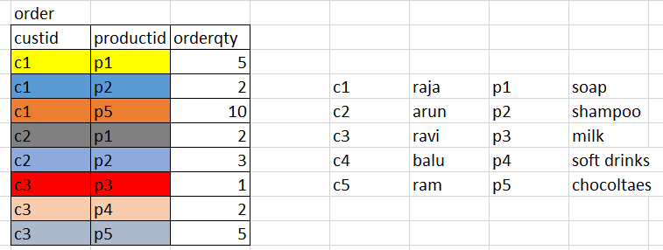
Order Example

Slide 73
Order
Customer_ID | Product_ID | Order_Quantity
1011 | 9023 | 10
1122 | 9023 | 15
1099 | 9031 | 20
1177 | 9031 | 18
1011 | 9111 | 50

Slide 74
Consider the Following Table
StudentID | StudentName | Department | DOB
1 | Raja | Computer Science & Engg | 10-12-1990
2 | Geetha | Computer Science & Engg | 12-12-1990
3 | Dev | Information Technology | 5-7-1990
4 | Preetha | Information Technology | 12-5-1998
5 | Hari | Computer Science & Engg | 10-3-1998
6 | Vani | Computer Science & Engg | 10-12-1990
7 | Krishna | Electrical&Electronics Engg | 12-12-1990
8 | Ajith | Electrical&Electronics Engg | 5-7-1990
9 | Ram | Information Technology | 12-5-1998
10 | Kumar | Computer Science & Engg | 10-3-1998
11 | Sandhya | Automobile Engg | 10-12-1990
12 | Uma | Automobile Engg | 12-12-1990

Slide 75
Deptname Gets Repeated more than once as more than one student belong to the same dept.
Also the size of the Department name is also big
Instead of the Department name with an Deptid can be represented as a separate table and the Deptid which is a primary key in the Dept table will be a Foreign key in the Student Table

Slide 76
Dept Table
DeptID | Department
1 | Computer Science & Engg
2 | Information Technology
3 | Electrical & Electronics Engg
4 | Automobile Engg
5 | Mechanical Engg

Slide 77
Student
StudentID | StudentName | DeptID | DOB
1 | Raja | 1 | 10-12-1990
2 | Geetha | 1 | 12-12-1990
3 | Dev | 2 | 5-7-1990
4 | Preetha | 2 | 12-5-1998
5 | Hari | 1 | 10-3-1998
6 | Vani | 1 | 10-12-1990
7 | Krishna | 3 | 12-12-1990
8 | Ajith | 3 | 5-7-1990
9 | Ram | 2 | 12-5-1998
10 | Kumar | 1 | 10-3-1998
11 | Sandhya | 4 | 10-12-1990
12 | Uma | 4 | 12-12-1990
Department
DeptID | Department
1 | Computer Science & Engg
2 | Information Technology
3 | Electrical & Electronics Engg
4 | Automobile Engg
5 | Mechanical Engg
DeptID is Primary Key in the Dept Table is acting as a Foreign key in the Student Table

Slide 78
Foreign keys are the columns of a table that points to the primary key of another table. They act as a cross-reference between tables.
Note: Practically, the foreign key has nothing to do with the primary key tag of another table, if it points to a unique column (not necessarily a primary key) of another table then too, it would be a foreign key. So, a correct definition of foreign key would be: Foreign keys are the columns of a table that points to the candidate key of another table.

Slide 79
Properties of Foreign Key
It states that if a foreign key exists in a relation then either the foreign key value must match a primary key value of some tuple in its home relation or the foreign key value must be null.
The rules are:
You can't delete a record from a primary table if matching records exist in a related table.
You can't change a primary key value in the primary table if that record has related records.
You can't enter a value in the foreign key field of the related table that doesn't exist in the primary key of the primary table.
However, you can enter a Null value in the foreign key, specifying that the records are unrelated.

Slide 80
ENTITY RELATIONSHIP DIAGRAM
Jack is part of database team and he needs to present the database design to business users. The business users are non-technical and it's difficult for them to read a verbose design document.
Jack needs to use an Entity Relation (ER) Model.
ER model is a graphical representation of entities and their relationships which helps in understanding data independent of the actual database implementation.

Slide 81
The ER model consists of basic objects called entities and a relationship among these objects.
Proposed by Peter Pin-Shan Chen (1976).
Three basic notations in ER model are
Entity sets
Relationship sets
Attributes

Slide 82
Entity
Objects in the miniworld about which information has to be stored. E.g. persons, books.
It must be possible to distinguish among entities
An entity may be
  Concrete -- person /Book.
  Abstract -- loan/holiday/Concept

Slide 83
Entity set
An entity set is set of entities of the same type that share the same properties/ Attributes.
Eg: set of all persons who are customers at a given bank can be defined as entity set customer.
Eg: set of all loans awarded by a bank is referred as entity set loan.
Note: entity sets do not need to be disjoint.
It is possible to define the entity set of all employees of a bank(employee) and the entity set of all customers of the bank (customer).
A person entity may be an employee entity, a customer entity, both or neither

Slide 84
Entity set loan and Customer
LOAN NO | AMOUNT
L17 | 1000
L23 | 3000
L15 | 1000
L17 | 1500
NAME | SOCIAL SECURITYNO | STREET
Jones | 321-12-3123 | Main
Smith | 019-28-5611 | North
Hayes | 912-51-1239 | north
Jack | 335-57-1298 | dupont

Slide 85
Attributes
An entity is represented by a set of attributes.
Attributes are descriptive properties possessed by each member of entity set
Possible attributes of the customer entity set are
  customer-name
  social security no
  street
Attributes of loan entity
  loan no
  amount

Slide 86
Domain
For each attributes there is a set of permitted values called domain or value set
Domain of attribute customer name
  set of all text strings of certain length
Domain of attribute loanno
  all positive integer in the form “L-n” eg L1, L2
Attributes of an entity set is a function that maps from the entity set in to a domain
Mapping between entity and domain
Entity is described by (attributes,datavalue)pairs {(name,jones), (social security,312-12-5123)…. ((street,main)}

Slide 87
Attributes Types
Simple and composite attributes
Single valued and multi valued attributes
Null attributes
Derived attributes
Simple attributes
The attributes simple in its structure, which cannot be further sub divided are referred as simple attributes. Eg: sex,etc.

Slide 88
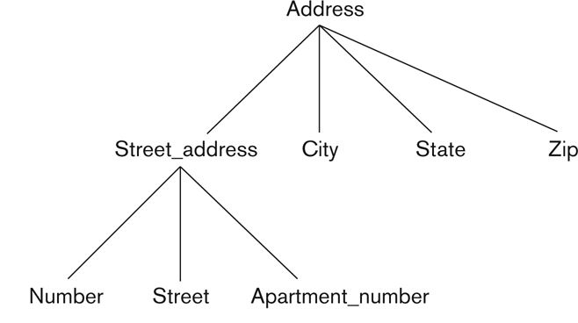
Hierarchy of Composite Attributes
Composite attributes:
The attribute may be composed of several components. It can be further sub divided Address(Apt#, House#, Street, City, State, ZipCode, Country)
Name(FirstName, MiddleName, LastName).

Slide 89
Single values attributes
Attributes have single value for particular entity eg: loan number attribute has a single loan number
Multivalued attributes
Attributes has a set of values for a specific entity consider an employee entity set dependent-name an employee can have zero, one or more dependents
Eg : In bio data-references-names
Educational qualifications sslc,hsc,ug,pg

Slide 90
Null attributes
A null value is used when an entity does not have a value for an attributes
Eg: One may have no middle name.
Derived attribute
The value for this type of attribute can be derived from the values of other related attributes/entities
Eg 1: entity : customer
Attributes : loans-held which represents how many no of loans a customer had from the bank. To derive the value this attribute, we can count the number of loans entities associated with that customer
Eg 2 entity : employee
Attributes: start-date; employment length
Employment length – total length of time the employee has worked. Value of employment –length can be derived from the value of start-date & current-date. Start-date is referred as base attributes

Slide 91
Relationship sets
Relationship is an association among several entities.
Relationship set is the relationship of the same type.
E.g. “X teaches course Y”.

Slide 92
Let us understand some key terms used in ER Modelling
Term | Definition | Examples
Entity | Real world objects which have an independent existence and about which we intend to collect data. | Employee, Computer
Attribute | A property that describes an entity. | Name, Salary

Slide 93
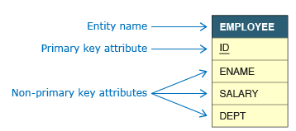
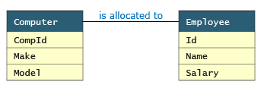
Different Forms
ID
ENAME
SALARY
DEPT
EMPLOYEE
Cus-street
SSN
balance
Cus-city
A/cno
cusname
Depositor
Customer
Account

Slide 94
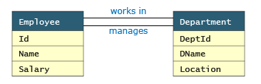
More than one relationship between entities
There can be more than one relationship between entities, e.g. an Employee works in a Department while the head of department (also an employee) manages a Department.

Slide 95
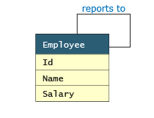
Recursive Relationship
If the same entity participates more than once in a relationship it is known as a recursive relationship. In the below example an employee can be a supervisor and be supervised, so there is a recursive relationship.
Eg: A women can take up the role of a wife, mother, daughter-in-law etc.

Slide 96
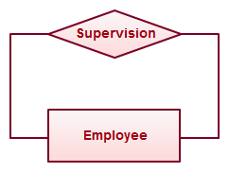
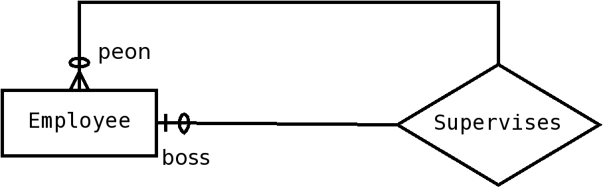
specifying that each employee has zero or one bosses (assuming the CEO doesn‘t have any boss), and that each employee may supervise zero or more other employees would look like

Slide 97
Degree of Relationships
The number of roles in the relationship
Binary – links two entity sets; set of ordered pairs (most common)
Ternary – links three entity sets; ordered triples (rare). If a relationship exists among the three entities, all three must be present
Ternary relationship set involving the entity sets customer, loan, branch.. customer jones, loan – L-17 and the perryridge branch.
N-ary – links n entity sets; ordered n-tuples (very rare). If a relationship exists among the entities, then all must be present. Cannot represesnt subsets.

Slide 98
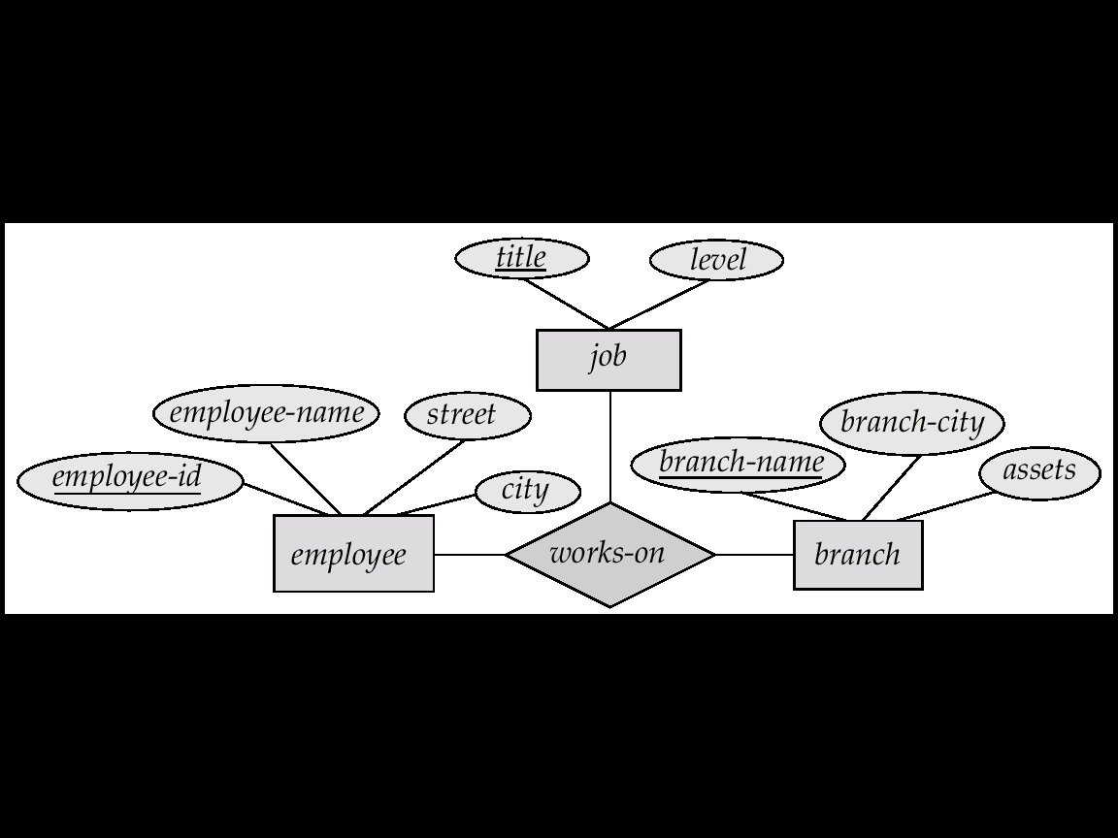
E-R Diagram with a Ternary Relationship

Slide 99
One - one
An entity in a is associated with at most one entity in b, and an entity in b is associated with at most one entity in A.
Borrower in a particular bank
A loan can belong to only customer.
1 Department one HOD

Slide 100

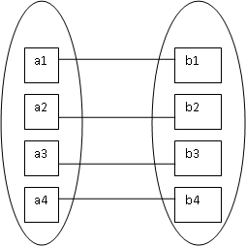
1-1

Slide 101
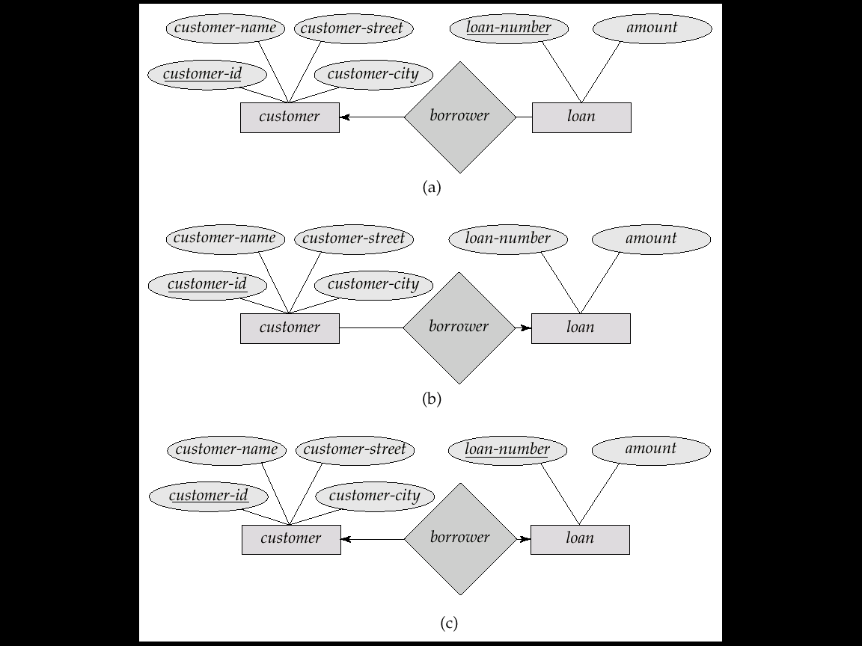
Cardinality Constraints
We express cardinality constraints by drawing either a directed line (→), signifying “one,” or an undirected line (—), signifying “many,” between the relationship set and the entity set.
E.g.: One-to-one relationship:
  A customer is associated with at most one loan via the relationship borrower
  A loan is associated with at most one customer via borrower

Slide 102

1-Many
An entity is A is associated with any number of entities in B. an entity in B, however can be associated with almost one entity in A.
b1
Depositor
1.customer may have several accounts.
a1
b2
a2
b3
a3
b4
b5

Slide 103
One-To-Many Relationship
In the one-to-many relationship a loan is associated with at most one customer via borrower, a customer is associated with several (including 0) loans via borrower

Slide 104
Many - 1
An entity in A is associated with atmost one entity in B. AN entity in B, however can be associated with any number of entities in A.
a1
a2
b1
a3
b2
a4
b3
a5

Slide 105
Many-To-One Relationships
In a many-to-one relationship a loan is associated with several (including 0) customers via borrower, a customer is associated with at most one loan via borrower

Slide 106
Many - Many
An entity in A is associated with any number of entities in B, and an entity in B is associated with any no of entities in A.
Loan can belong to several customers can loans can be taken jointly by several business partners
a1
b1
a2
b2
a3
b3
a4
b4

Slide 107
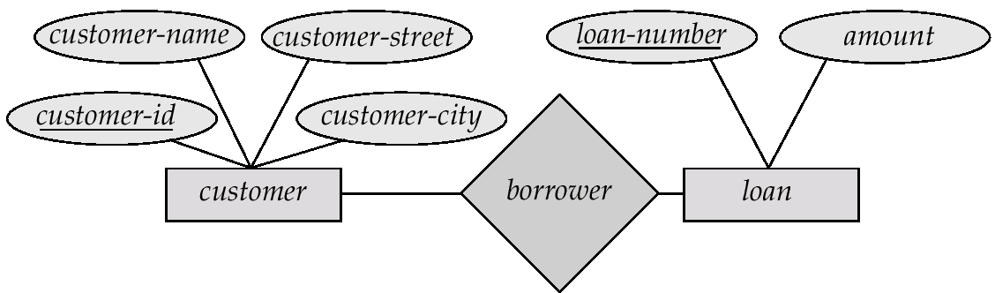
Many-To-Many Relationship
A customer is associated with several (possibly 0) loans via borrower
A loan is associated with several (possibly 0) customers via borrower

Slide 108
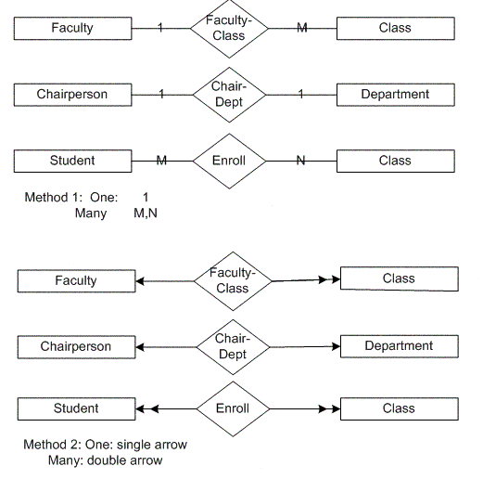

Slide 109
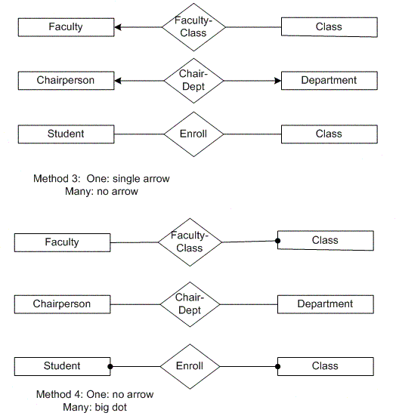

Slide 110
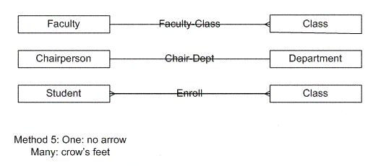

Slide 111
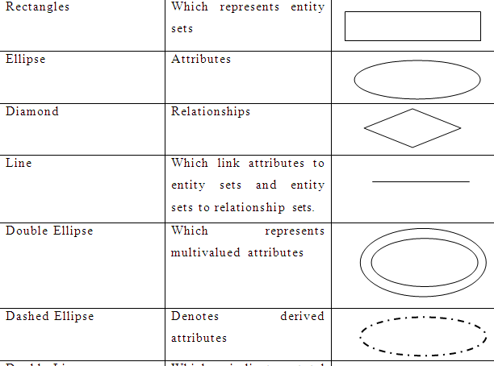

Slide 112
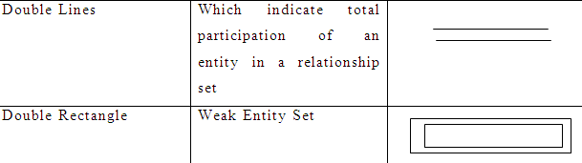
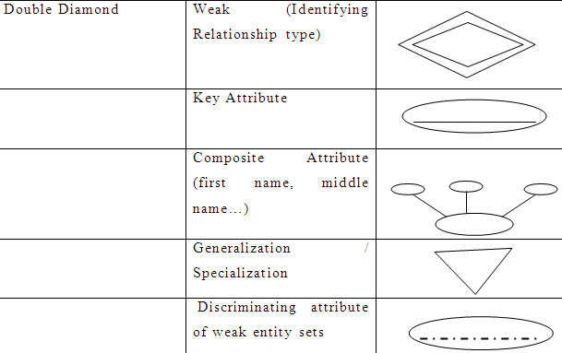

Slide 113
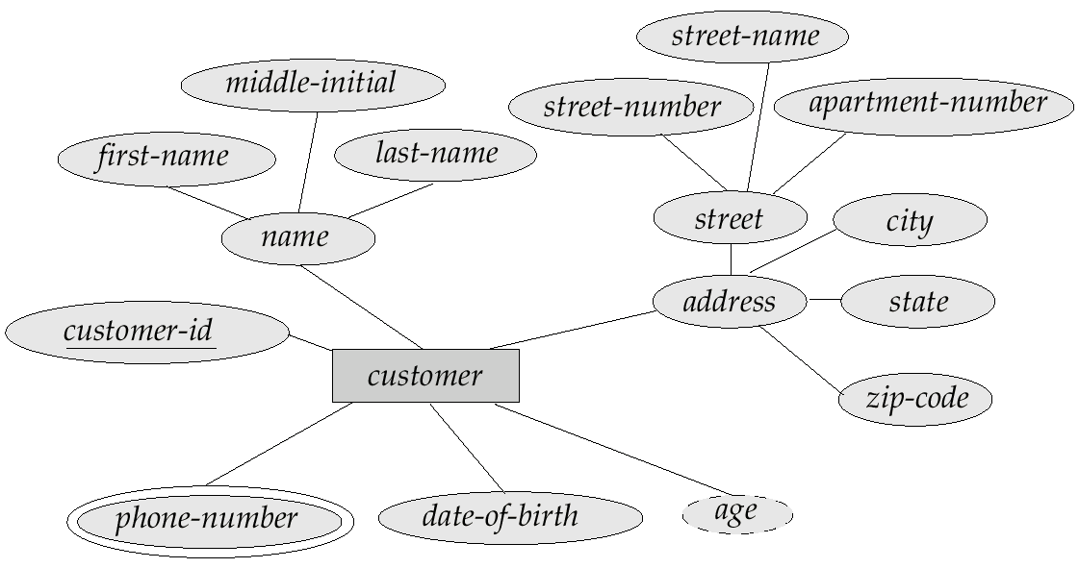
E-R Diagram With Composite, Multivalued, and Derived Attributes
Composite Attribute – name, address , street
Multivalued Attribute = phone number depicted by double ellipse
Derived attribute = age depicted by dashed ellipse

Slide 114

How to Create an Entity Relationship Diagram (ERD)

Slide 115
Scenario
In a university, a Student enrolls in Courses. A student must be assigned to at least one or more Courses. Each course is taught by a single Professor. To maintain instruction quality, a Professor can deliver only one course

Slide 116
Step 1) Entity Identification
Student
Course
Professor

Slide 117

Step 2) Relationship Identification
Identify the association between the entities
The student is assigned a course
Professor delivers a course

Slide 118
Step 3) Cardinality Identification
A student can be assigned multiple courses
A Professor can deliver only one course

Slide 119
Step 4) Identify Attributes
Entity | Primary Key | Attribute
Student | Student_ID | StudentName
Professor | Employee_ID | ProfessorName
Course | Course_ID | CourseName

Slide 120
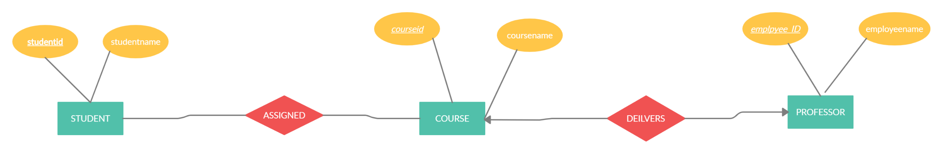

Slide 121
ER DIAGRAM
“Patients are treated in a single ward by the doctors assigned to them.
Usually each patient will be assigned a single doctor, but in rare cases they will have two. Healthcare assistants also attend to the patients, a number of these are associated with each ward.

Slide 122
Step 1) Entity Identification
Patients
Doctor
healthcareAssistants
ward

Slide 123
Step 2) Relationship Identification
Identify the association between the entities
Patients are treated in ward
Patient are assigned to doctor
Healthcare assistants attends to patients

Slide 124
Step 3) Cardinality Identification
Patients are treated in single ward (M:1)
Patient are assigned to doctor(1:M)
Healthcare assistants attends to patients (M:M)

Slide 125
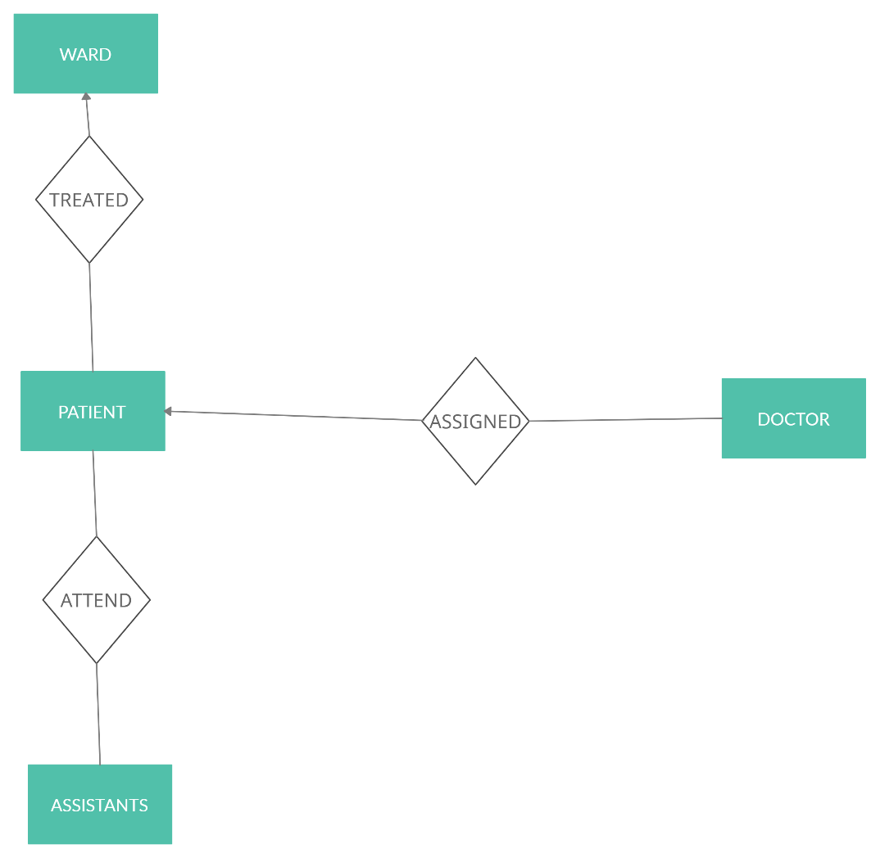

Slide 126
DFD Examples

Slide 127
Why Data Flow Diagram
A picture is worth a thousand words.
A Data Flow Diagram (DFD) is a traditional way to visualize the information flows within a system.
It shows
  how information enters the System
  How Information leaves the system
  what changes the information
  where information is stored.

Slide 128
Good DFDs are critical to the process
Building DFDs == understanding the system
Analyzing DFDs == understanding the threats

Slide 129
DFD Types of Notation
Yourdon & Coad
Gene & Sarson are the two main methods of notation used in DFDs

Slide 130
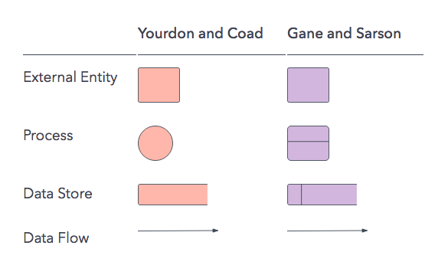
Elements of DFD

Slide 131
External Entity
An external agent is a source or destination of data
The sharp cornered rectangles(or simply boxes) in a DFD indicates entities.
An external entity, which are also known as terminators, sources, sinks, or actors, are an outside system or process that sends or receives data to and from the diagrammed system

Slide 132
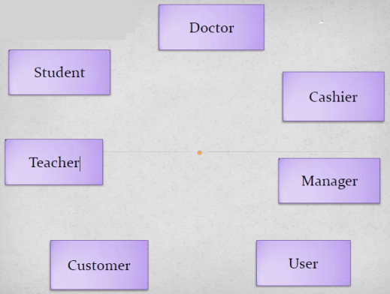
Entities are people things, organizations etc of data from the system

Slide 133
Process
A process is a unit of work that operates on the data
The rounded cornered rectangles or circles in a DFD indicate processes
Process is a procedure that manipulates the data and its flow by taking incoming data, changing it, and producing an output with it

Slide 134
Examples of Process

Slide 135
Data Store
Opened sided rectangles in DFD indicates data store.
The Data Store symbol represents data that is not moving (delayed data at rest).
A Data Store is a logical repository of data.
Data can be written into the data store. This is depicted by an incoming arrow.
Data can be read from a data store. This is depicted by an outgoing arrow.

Slide 136
Data store
Two data stores cannot be connected by a data flow.
External entity cannot read or write to the data store.

Slide 137
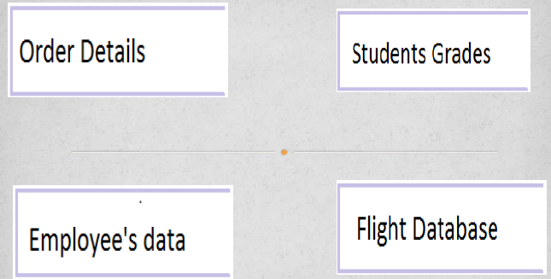
Examples of data store

Slide 138
Data flow
Data flow is the path the system’s information takes from external entities through processes and data stores. With arrows and succinct labels, the DFD can show you the direction of the data flow.
Arrow symbol in DFD indicate data flow
The Data Flow symbol represents movement of data

Slide 139
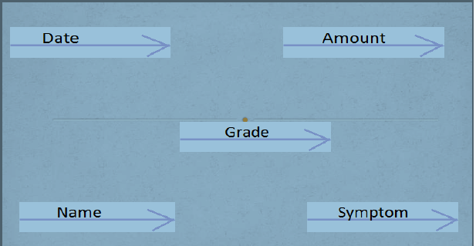
Examples of Data Flow

Slide 140
Rules of Data Flow
Data can flow from
External Entity to Process
Process to External Entity
Process to Data Store and back
Process to Process

Slide 141
Rules of Data Flow
Data cannot flow from
External entity to External Entity
External entity to store
Data store to External Entity
Data store to Data Store

Slide 142
Four rules of thumb to create a valid DFD.
Each process should have at least one input and one output.
Each data store should have at least one data flow in and data flow out.
A system’s stored data must go through a process.
All processes in a DFD must link to another process or data store.

Slide 143
Creating Data Flow Diagrams
Steps:
Create a list of activities
Construct Context Level DFD
(identifies external entities and processes)
Construct Level 0 DFD
(identifies manageable sub process )
Construct Level 1- n DFD
(identifies actual data flows and data stores )
Check against rules of DFD

Slide 144
DFD Naming Guidelines
External Entity → Noun
Data Flow → Names of data
Process → verb phrase
  a system name
  a subsystem name
Data Store → Noun

Slide 145
Creating Data Flow Diagrams
Lemonade Stand Example

Slide 146
Creating Data Flow Diagrams
Example
Steps:
The operations of a simple lemonade stand will be used to demonstrate the creation of dataflow diagrams.
Create a list of activities
  New way: use Use-Case Diagram
Construct Context Level DFD
(identifies sources and sink)
Construct Level 0 DFD
(identifies manageable sub processes )
Construct Level 1- n DFD
(identifies actual data flows and data stores )

Slide 147
Creating Data Flow Diagrams
Example
Create a list of activities
Think through the activities that take place at a lemonade stand.
Customer Order
Produce Product
Serve Product
Collect Payment
Store Product

Slide 148
Creating Data Flow Diagrams
Example
Create a list of activities
Also think of the additional activities needed to support the basic activities.
Customer Order
Produce Product
Serve Product
Collect Payment
Store Product
Order Raw Materials
Pay for Raw Materials
Pay for Labor

Slide 149
Creating Data Flow Diagrams
Example
Create a list of activities
Group these activities in some logical fashion, possibly functional areas.
Customer Order
Serve Product
Collect Payment
Produce Product
Store Product
Order Raw Materials
Pay for Raw Materials
Pay for Labor

Slide 150
 | Process
Customer Order | Sale
Serve Product
Collect Payment
Produce Product (product preparation) | Production
Store Product
Order Raw Materials | Procurement
Pay for Raw Materials
Pay for Labor | payroll

Slide 151
Context Level DFD
Basic form of DFD
Called as Level 0
Shows how the system works at a Glance
There is only one process(Main Process) in the system and all the data flows either into or out of this process.

Slide 152
Context level DFD’s demonstrates the interactions between the process and external entities.
They do not contain Data Stores.

Slide 153
Creation of Context Level DFD
Identify the main system (Lemonade)
Identify the external people who interact with the system
  Customer
  Employee (Seller)
  Vendor (for purchasing Raw Materials)

Slide 154
Decide what data these entities will enter into the system
Determine what these entities expect as output from the system

Slide 155
Creating Data Flow Diagrams
Example
Construct Context Level DFD
(identifies sources and sink)
Create a context level diagram identifying the sources and sinks (users).
Context Level DFD
CUSTOMER
0.0
Lemonade System
Sales Forecast
EMPLOYEE
Customer Order
Serve Product
Collect Payment
Produce Product
Store Product
Order Raw Materials
Pay for Raw Materials
Pay for Labor
Order
Produce Product
Product Served
Pay
Payment
Time Worked
Received Goods
Payment
Purchase Order
VENDOR

Slide 156
Creating Data Flow Diagrams
Example
Construct Level 0 DFD
(identifies manageable sub processes )
Create a level 0 diagram identifying the logical subsystems that may exist.
Level 0 DFD
1.0
Sale
Customer Order
Serve Product
Collect Payment
Produce Product
Store Product
Order Raw Materials
Pay for Raw Materials
Pay for Labor
Customer Order
Sales Forecast
Product Ordered
CUSTOMER
Payment
2.0
Production
EMPLOYEE
Produce
Product
Product Served
Received Goods
Inventory
VENDOR
3.0
Procure-ment
Purchase Order
Order
Decisions
Payment
Pay
Time Worked
4.0
Payroll

Slide 157
Create a level 1 decomposing the processes in level 0 and identifying data stores
In the Level 0 with respect to 1.0 Sale

Slide 158
Main Process | Sub Process | Data Stores
Sale | Customer Order | Customer , Order
 | Payment | Order, Payment
 | Sales forecast | Payment

Slide 159

Creating Data Flow Diagrams
Example
Construct Level 1- n DFD
(identifies actual data flows and data stores )
Create a level 1 decomposing the processes in level 0 and identifying data stores.
Level 1 DFD
CUSTOMER
Customer Order
Customer Order
Serve Product
Collect Payment
Produce Product
Store Product
Order Raw Materials
Pay for Raw Materials
Pay for Labor
ORDER
Request for Forecast
1.1
Record Order
1.3
Produce Sales Forecast
Severed Order
Payment
Sales Forecast
1.2
Receive Payment
PAYMENT

Slide 160

Creating Data Flow Diagrams
Example
Construct Level 1 (continued)
Create a level 1 decomposing the processes in level 0 and identifying data stores.
Level 1 DFD
Product Order
ORDER
Customer Order
Serve Product
Collect Payment
Produce Product
Store Product
Order Raw Materials
Pay for Raw Materials
Pay for Labor
2.1
Serve Product
Quantity Severed
RAW MATERIALS
Production
Schedule
2.2
Produce Product
Quantity Used
INVENTORTY
Production Data
2.3
Store
Product
Quantity Produced & Location Stored

Slide 161

Creating Data Flow Diagrams
Example
Construct Level 1 (continued)
Create a level 1 decomposing the processes in level 0 and identifying data stores.
Level 1 DFD
Order Decision
3.1
Produce Purchase Order
PURCHASE ORDER
Customer Order
Serve Product
Collect Payment
Produce Product
Store Product
Order Raw Materials
Pay for Raw Materials
Pay for Labor
Quantity On-Hand
RAW MATERIALS
Quantity
Received
Received Goods
3.2
Receive Items
RECEIVED ITEMS
Payment Approval
3.3
Pay Vendor
VENDOR
Payment

Slide 162
Creating Data Flow Diagrams
Example
Construct Level 1 (continued)
Create a level 1 decomposing the processes in level 0 and identifying data stores.
Level 1 DFD
Time Worked
4.1
Record Time Worked
TIME CARDS
Customer Order
Serve Product
Collect Payment
Produce Product
Store Product
Order Raw Materials
Pay for Raw Materials
Pay for Labor
Employee ID
EMPLOYEE
Payroll Request
4.2
Calculate Payroll
Unpaid time cards
PAYROLL
Payment Approval
4.3
Pay Employee
PAYMENTS
Payment

Slide 163
Process Decomposition
1.0
Sale
1.1
Record Order
1.2
Receive Payment
2.0
Production
2.1
Serve Product
2.2
Produce Product
2.3
Store
Product
0.0
Lemonade System
3.0
Procure-ment
3.1
Produce Purchase Order
3.2
Receive Items
3.3
Pay Vendor
4.0
Payroll
4.1
Record Time Worked
4.2
Calculate Payroll
4.3
Pay Employee
Context Level
Level 0
Level 1

Slide 164
Let us try to identify some candidate keys for this relation
Key | Rationale
EmployeeNo | This seems to be a good candidate key as companies usually issue a unique number for each employee.
AadharNo | This seems to be a good candidate key for a company based in India. However we have assumed that every employee has an Aadhar number which may not be true. In addition for a multinational firm with employees across the globe this will not work at all.
Name, DateOfBirth | This might work for a small firm of 10 people as a combination of Name and Date of Birth is likely to be unique.
Salary | This is not a good candidate as salary is generally paid uniformly to people at same level.
EmployeeNo, DateOfBirth | It is not a candidate key as EmployeeNo alone is unique. By definition only minimal set of attributes can be candidate key.
Thus the choice of candidate key depends upon the business context.

Slide 165
Key | Rationale
EmployeeNo | Good candidate as it is numeric, cannot be null and does not change with time.
AadharNo | It will be null for people who do not have Aadhar number. Hence it cannot be considered as primary key.
Name, DateOfBirth | Both Name and DateOfBirth cannot be null. However even if uniqueness is guaranteed, it is not a good choice due to large size.
When two or more columns together identify the unique row then it's referred to as Composite Primary Key. The combination of Name and DateOfBirth if selected as a primary key would be a composite primary key.

Slide 166
Database Users and Administrators
Primary goal of the database system is to retrieve information and store new information in the database
2 Types of Users
Database Users
Database Administrators

Slide 167
Database Users
4 Types of Database Users
Naive users
Application Programmers
Sophisticated Users
Specialized Users

Slide 168
Naïve Users
They are unsophisticated users who interact with the system by invoking one of the application program that have been written previously.
Simple User, who operates the applications
Does not write any code

Slide 169
Application Programmers
They are computer professionals who write application programs.
Application programmers can choose from many tools to develop user interfaces.

Slide 170
Sophisticated Users
They interact with the system without writing programs.
Instead they write their requests in a database query language

Slide 171
Specialized Users
They are sophisticated users who write specialized database applications that do not fit in to the traditional data-processing frame work.

Slide 172
Database Administrator
DBA is the person or group that is responsible for supervising both the data base and the use of the DBMS
Roles of DBA
Policy Formulation and Implementation
Access privileges
Security
Disaster planning
Archives
Data Dictionary Management
Training
DBMS Support
DBMS evaluation and selection
DBMS responsibility
Data Base Design

Slide 173
DBA formulates policies and communicates these policies to users.
Among these policies are those covering access
privilege,
security,
disaster planning,
archives.

Slide 174
AccessPrivilege
Access to every table and field in the database is not a necessity for every user.
User A Access denide Access permitted

Slide 175
Security
Security refers to the prevention of unauthorized access to the database
Once access privilege have been specified and security features are in place,
DBA draws up policies to explain the security privileges and then distributes these policies to authorized users.

Slide 176
Planning for Disaster
A database may be harmed by some physical problems or by some natural disasters.
For this the DBA’s responsibility is to establish and implement backup and recovery procedures.

Slide 177
Archives
This tells that data need to be kept in the database for only a limited time.
A data archive is a place where a record of certain corporate data is kept
Data Dictionary Management (Data About Data)
Data dictionary contains a wider range of information, including at the very least, information on tables, indexes, and programs.
The creation and distribution of appropriate reports from the data dictionary is another of DBA”s responsibility.

